Slide 1
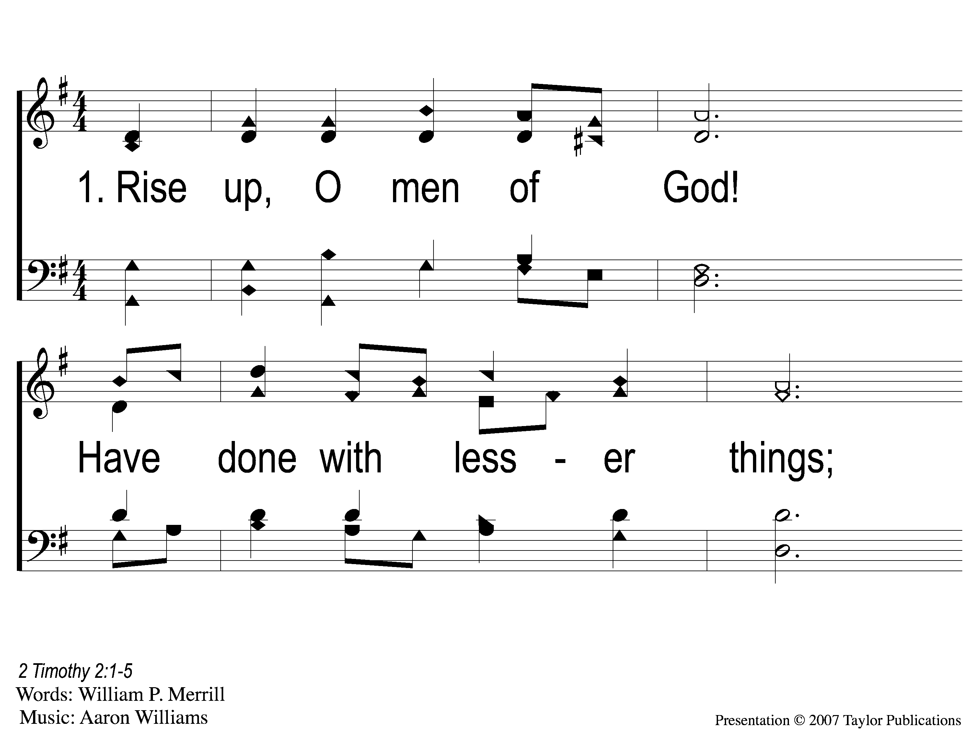
1-1 Rise Up O Men of God
Rise Up, O Men of God
66

Slide 2
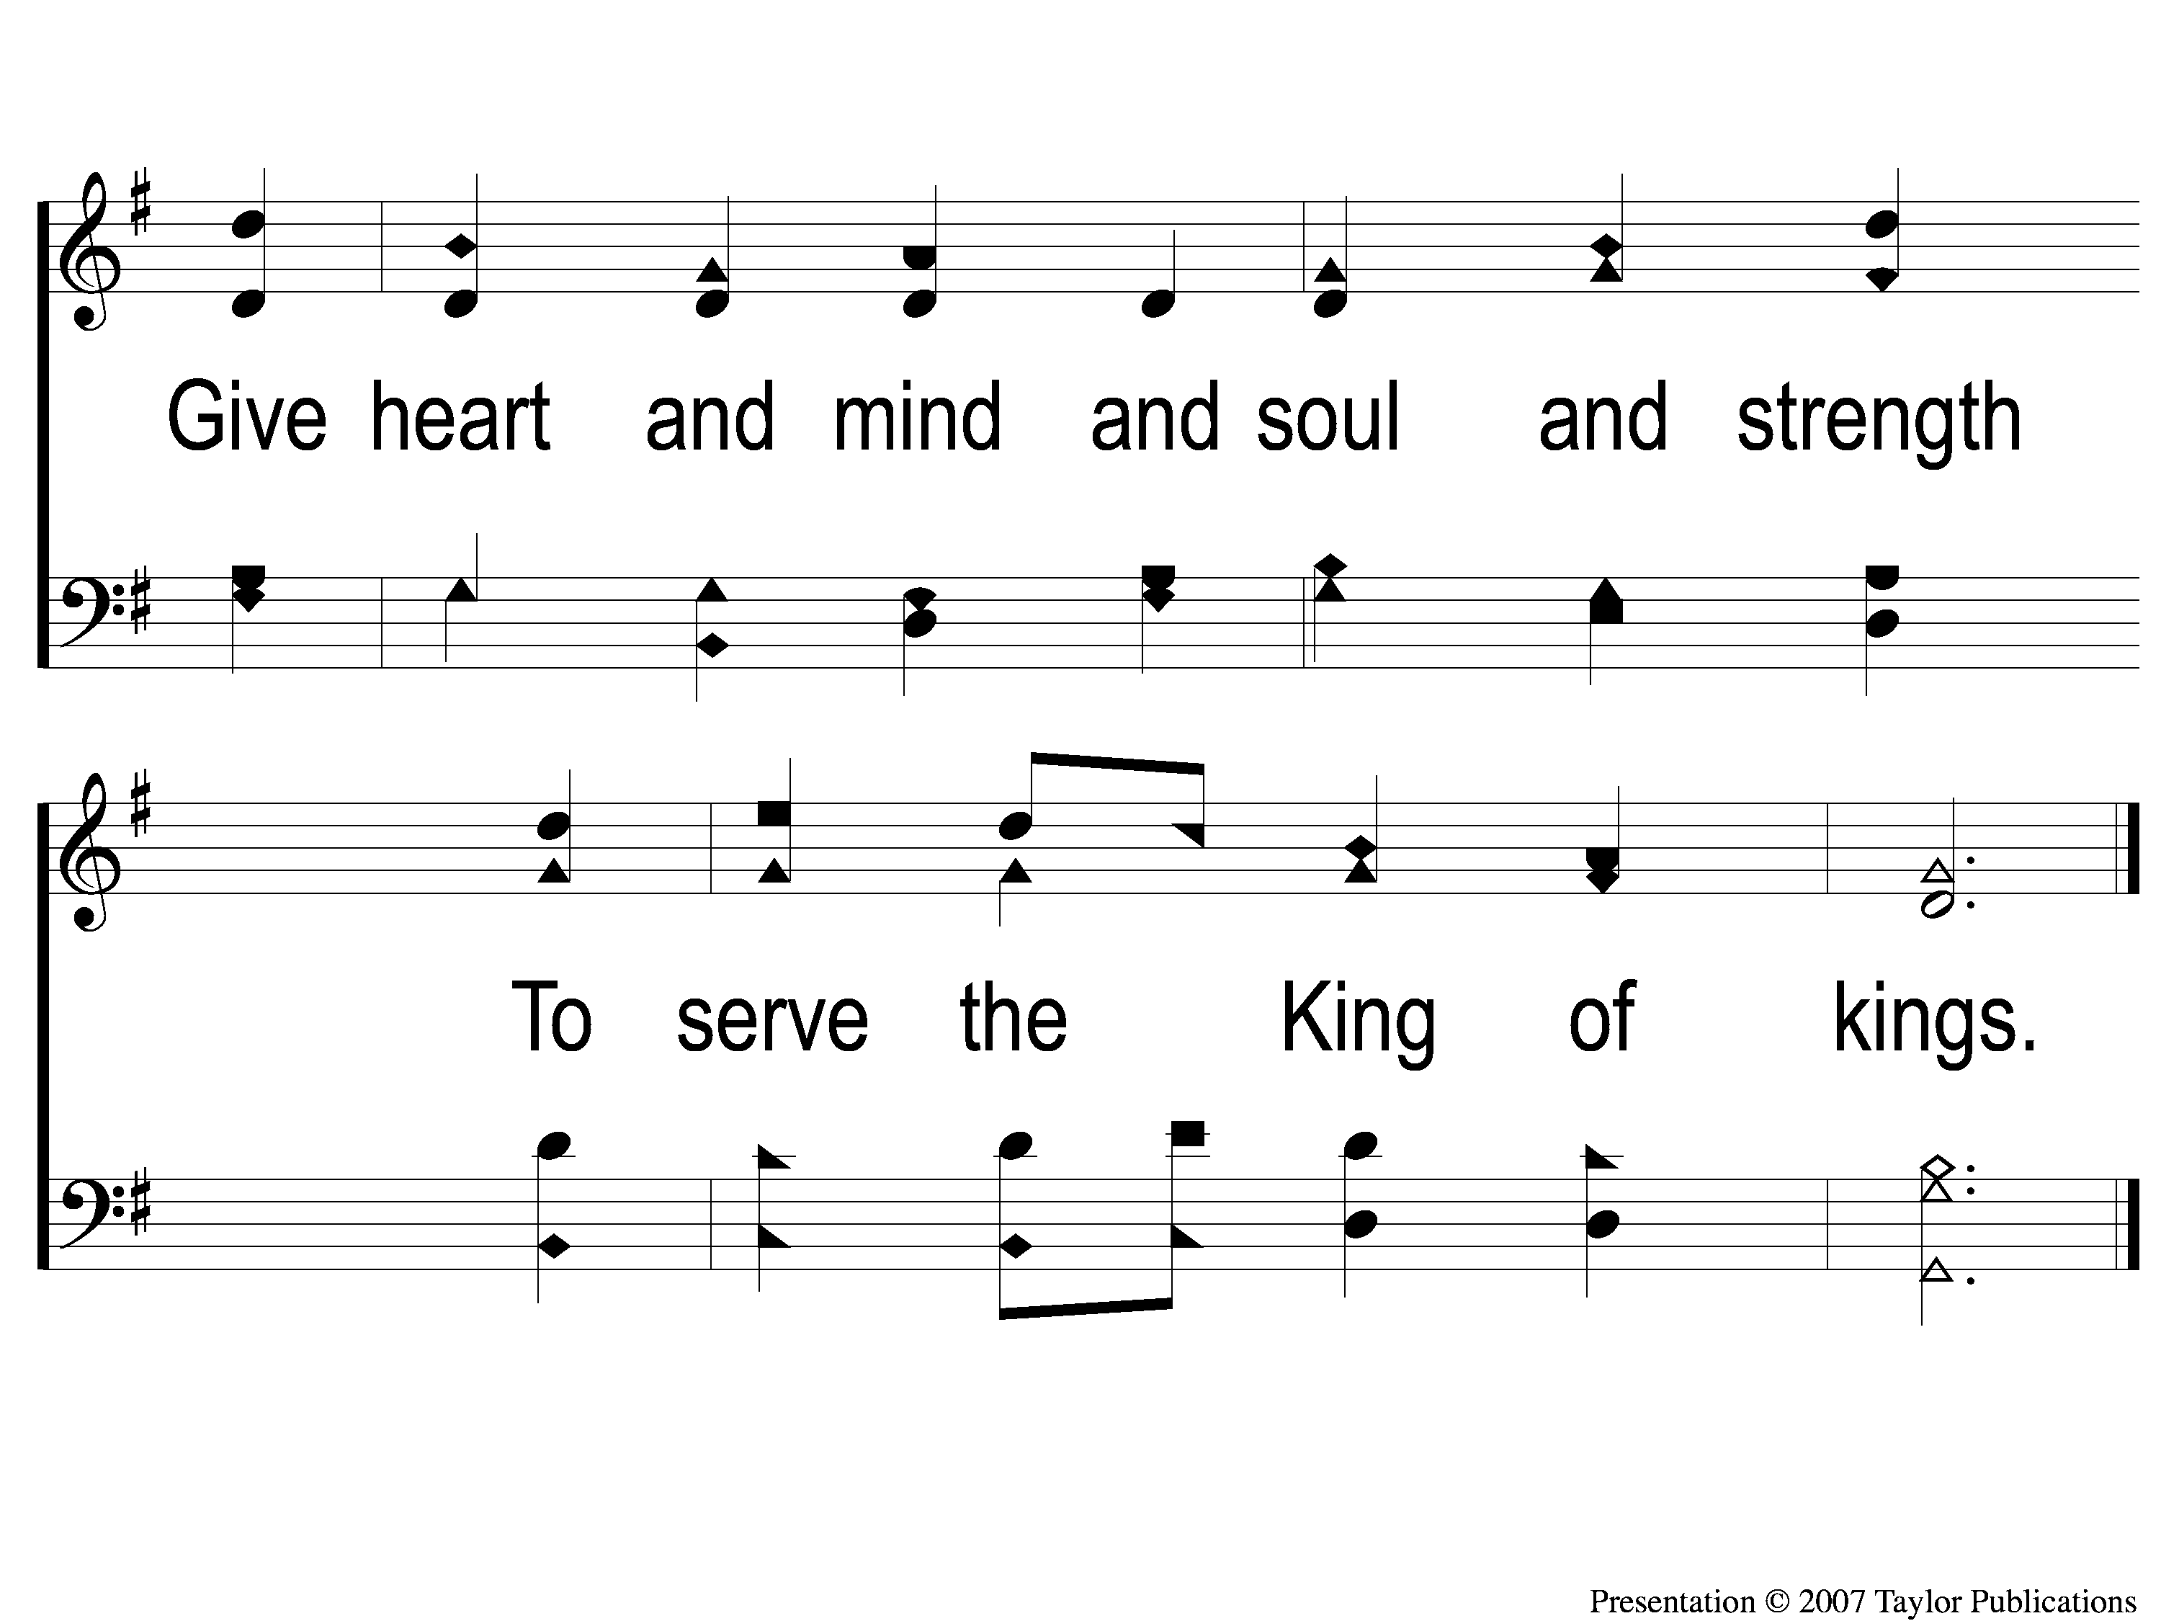
1-2 Rise Up O Men of God
Rise Up, O Men of God
66

Slide 3
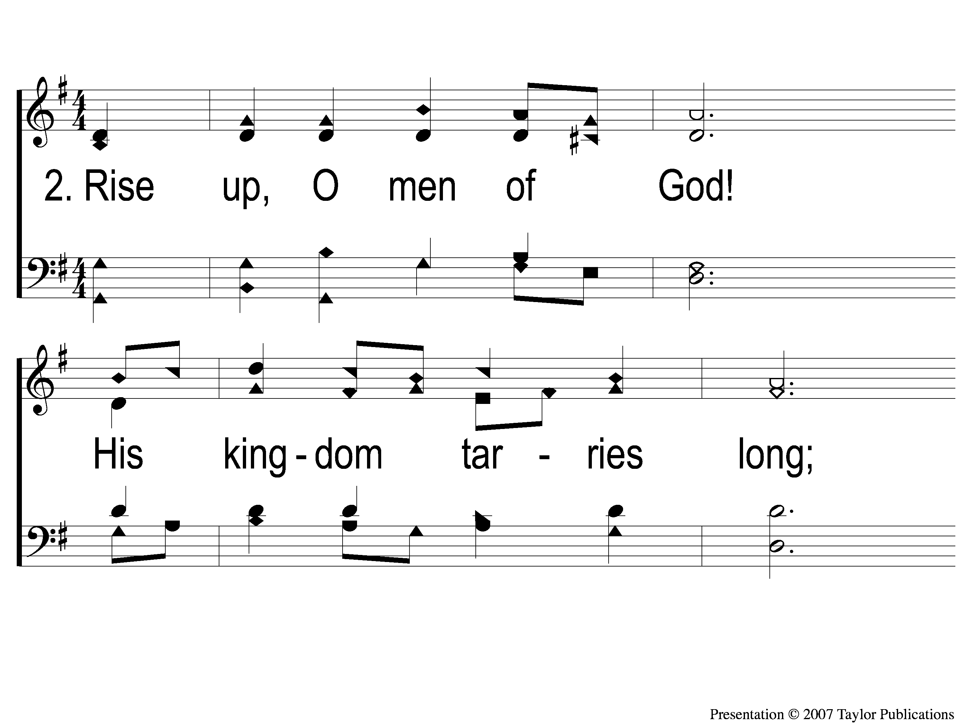
2-1 Rise Up O Men of God
Rise Up, O Men of God
66

Slide 4
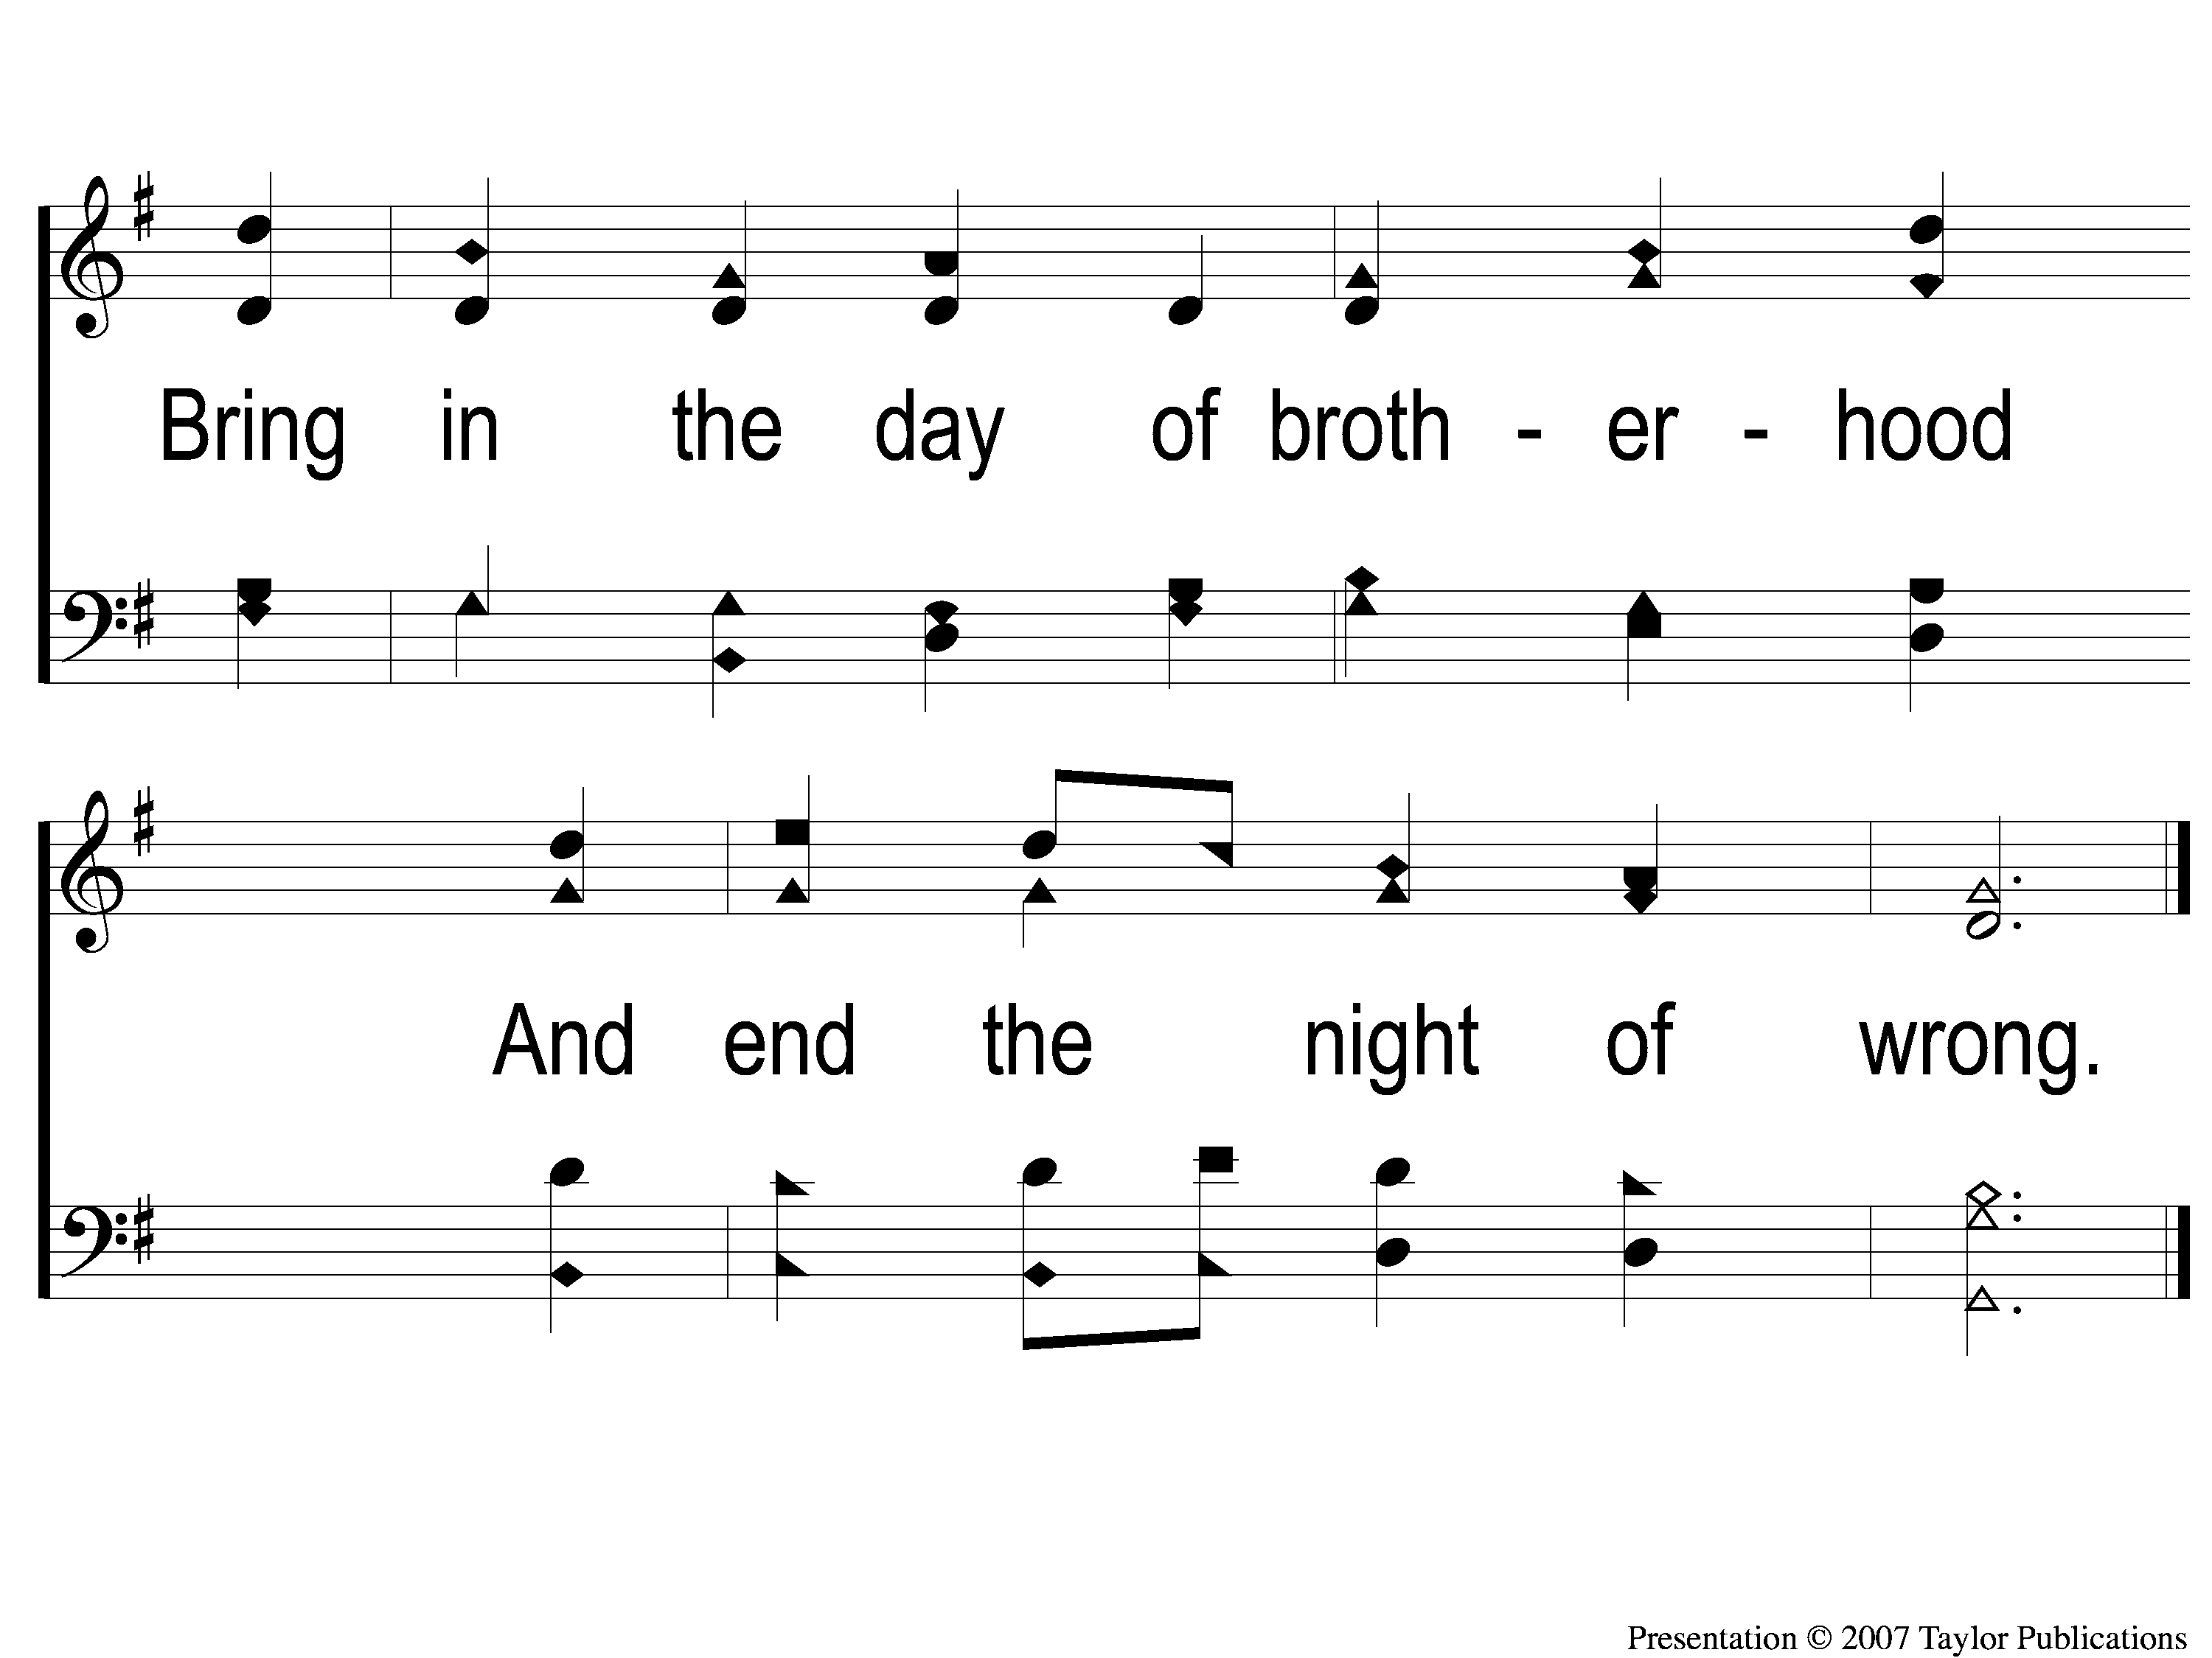
2-2 Rise Up O Men of God
Rise Up, O Men of God
66

Slide 5
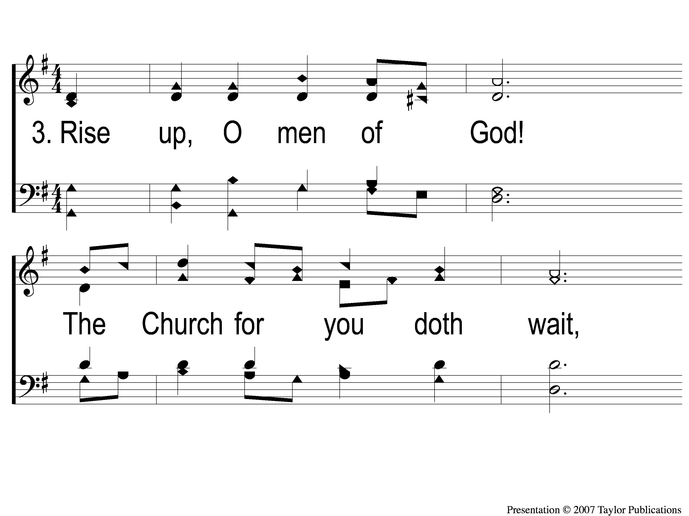
3-1 Rise Up O Men of God
Rise Up, O Men of God
66

Slide 6
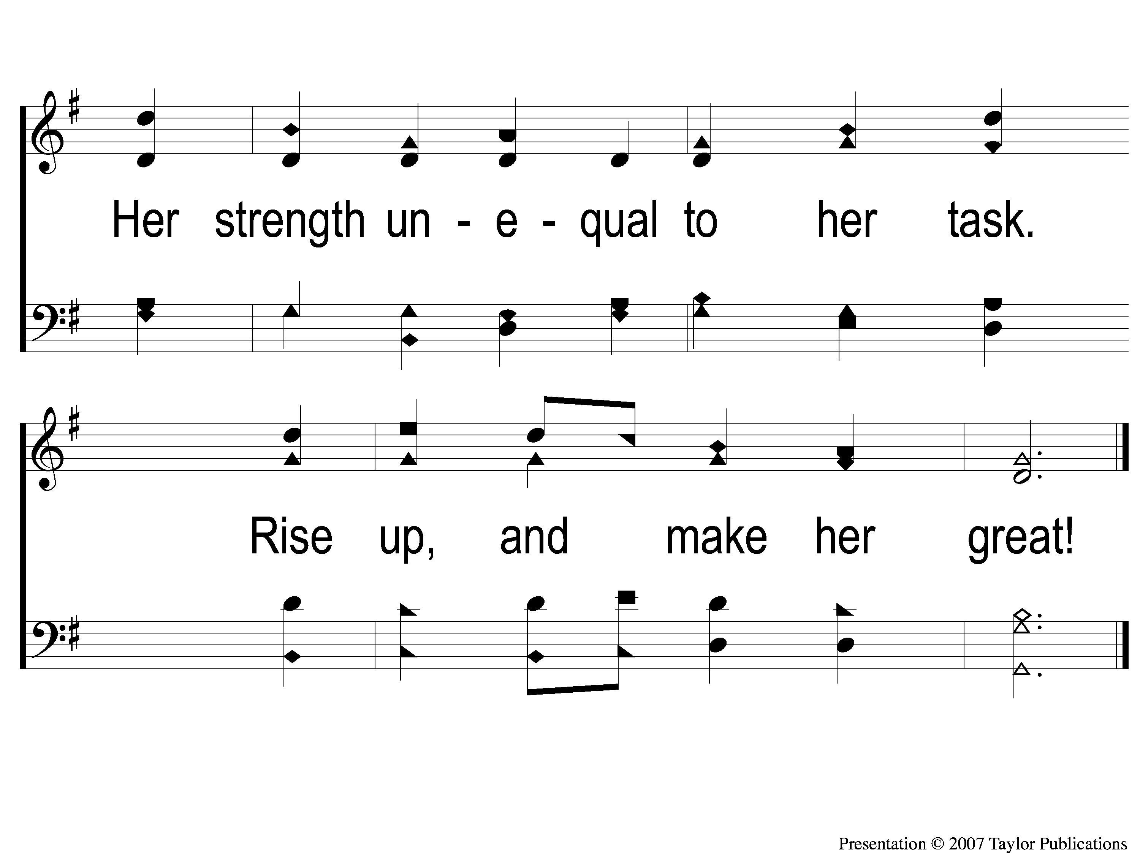
3-2 Rise Up O Men of God
Rise Up, O Men of God
66

Slide 7
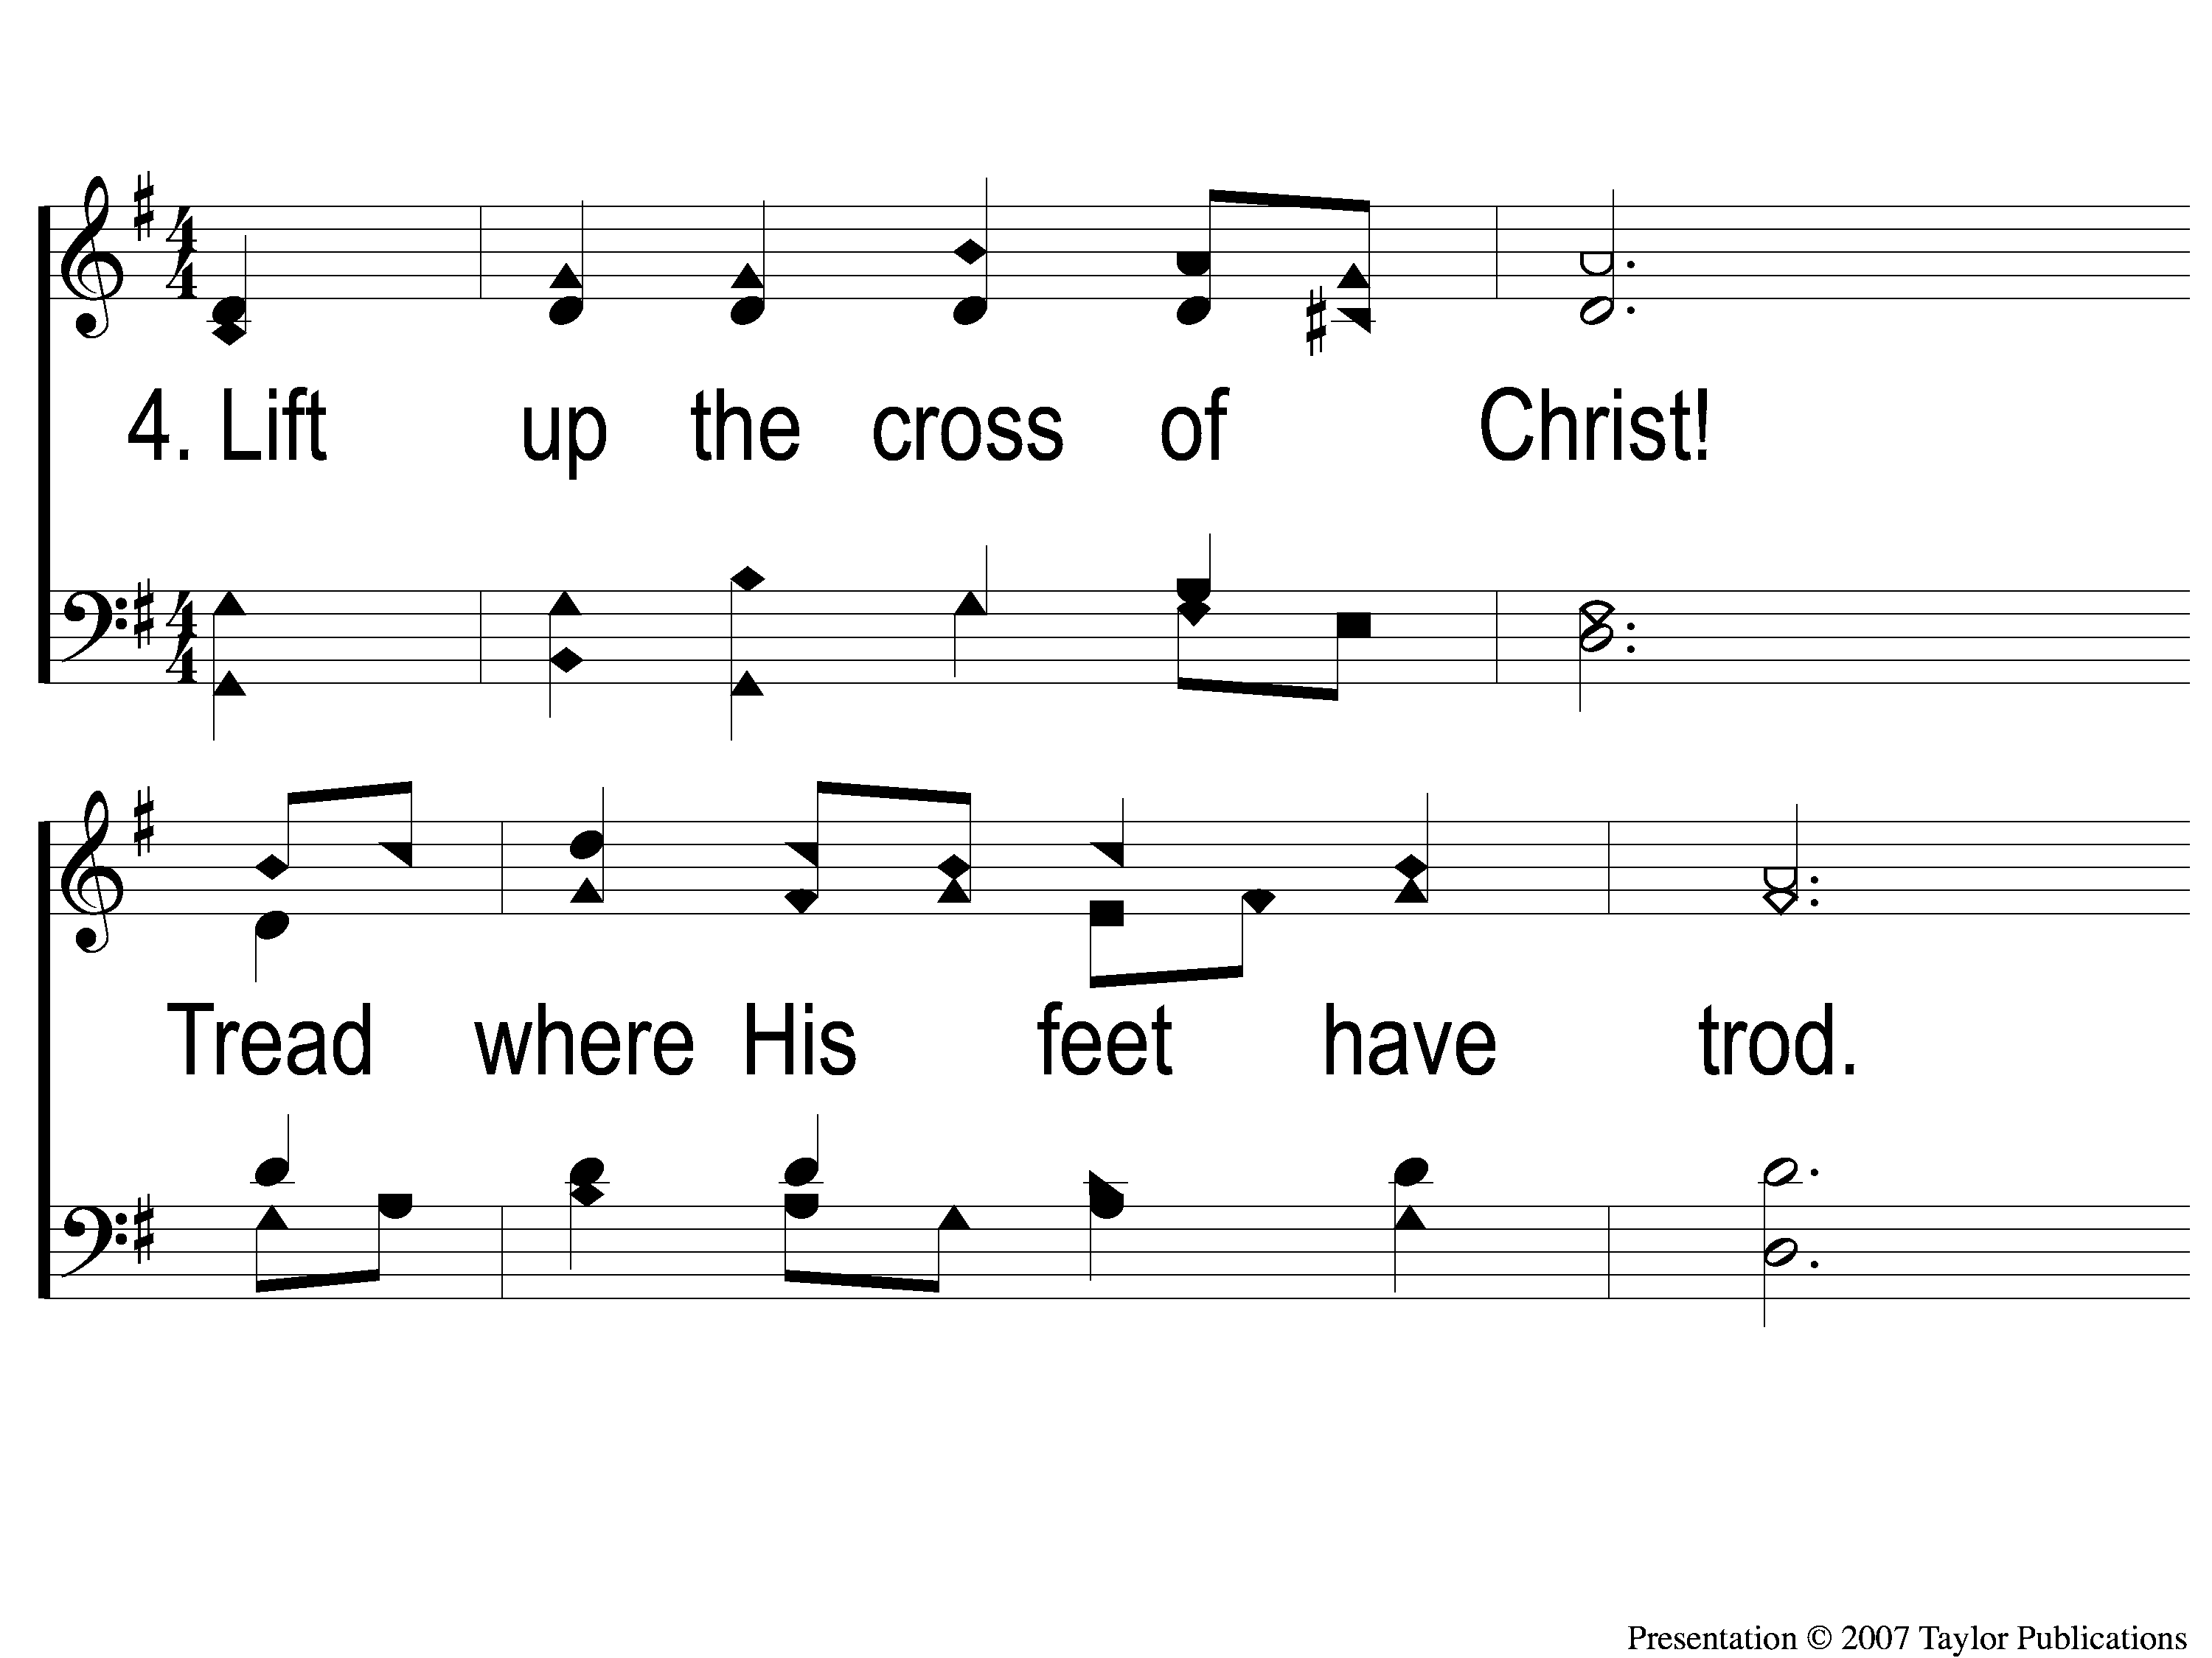
4-1 Rise Up O Men of God
Rise Up, O Men of God
66

Slide 8
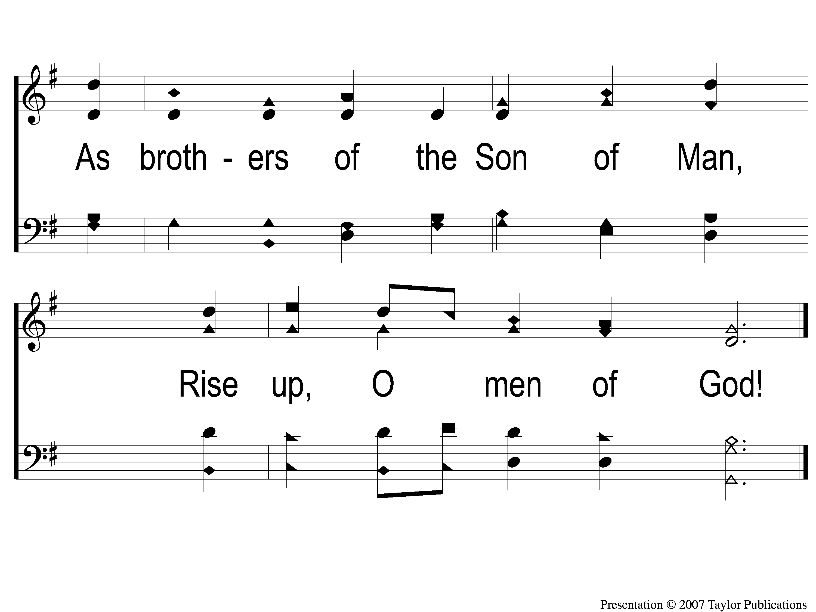
4-2 Rise Up O Men of God
Rise Up, O Men of God
66

